Slide 1


Health Economics Lecture #6
Topic: The Political Economy of Healthcare Provision
Prepared by Jacob Smith, Trent University

Slide 2
Learning Objectives
In this lecture we will discuss:
How to think about healthcare systems
Physician Payment Models: Fee for Service VS Capitation.
Canadian Healthcare: The Provincial Schedule of Medical Benefits.
Goal of this Lecture:
Understand different models of physician payment and how these payment schemes impact their behaviour.

Slide 3
Thinking about healthcare systems

Slide 4
Thinking about healthcare systems
In the paper Five types of OECD healthcare systems: Empirical results of a deductive classification by Böhm et al 2013 classify 30 different OCED advanced country healthcare systems according to three main dimensions:
Regulation.
Financing.
Service Provision.
With provision by three different actors:
State based
Societal-private non profit providers
Private- referring to market based actors

Slide 5
Regulation
Given that the market for healthcare is one with assyemtric information between patients and providers, regulation in healthcare is important because it ensures quality of care.
Examples of regulation through each of the three actors are as follows:
State based
Licensing of healthcare professionals.
Drug approval by govt agencies.
Public health mandates (i.e. infection control laws).
Societal
Medical association regulation (i.e. OMA (doctors), CDHA (dental hygenists))
Non government watchdog groups.
Private
Hospital accreditation bodies.
Insurance company utilization reviews.
Corporate compliance programs.

Slide 6
Financing
When discussing health system financing, there is an interest in how doctors and other healthcare personnel gets paid for their services
Examples of Financing through each of the three actors are as follows:
State based
Tax funded healthcare system.
Societal
Community based health insurance (CBHI).
Mutual Aid Programs (i.e. fundraisers or pooled funds).
Private
Out of pocket payment.
Private insurance.

Slide 7
Service Provision
When describing a healthcare system in terms of service provision, this means describing the kind of employment contracts health care providers have
Examples of service provision through each of the three actors are as follows:
State based
Government ownership and operation of hospitals, clinics and public health services.
Healthcare providers are often public employees who are salaried.
Societal
NGOs, faith-based hospitals and community health networks.
Private
Providers can be independent contractors, and hospitals and clinics operate in a private capacity for profit.

Slide 8
A Short List of HealthCare Systems
Healthcare system type | Regulation | Financing | Provision | Countries
National Health Service | State | State | State | Denmark, Finland, Iceland, Norway, Sweden, Portugal, Spain, U.K.
National Health Insurance | State | State | Private | Australia, New Zealand, Canada, Italy, Ireland
Social Health Insurance | Societal | Societal | Private | Austria, Luxembourg, Germany, Switzerland
Private Health System | Private | Private | Private | USA
Etatist Social Health Insurance | State | Societal | Private | Estonia, France, Czech Republic, Hungary, Netherlands, Slovakia, Israel, Japan, Korea
Social-based mixed type | Societal | Societal | State | Slovenia

Slide 9
Physician Payment Models

Slide 10
Physician Payment Models
There are three main reimbursement models by which physicians can be paid by.
They are:
Salaried/Fixed Payment.
Fee for Service.
Capitation/Per Capita.
Each of these payment models provide different incentives for providing care.

Slide 11

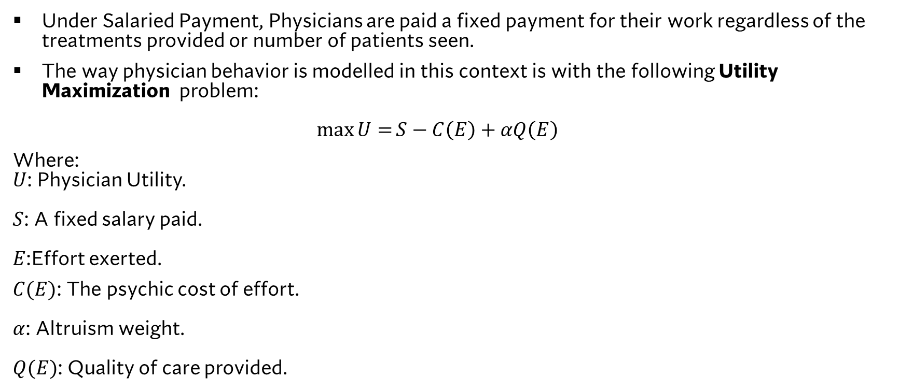
Physician Behavior: Salaried Payment
Under Salaried Payment, Physicians are paid a fixed payment for their work regardless of the treatments provided or number of patients seen.
The way physician behavior is modelled in this context is with the following Utility Maximization problem: $\max{U=}S−C\left(E\right)+αQ\left(E\right)$
Where: $U$: Physician Utility. $S$: A fixed salary paid. $E$:Effort exerted.
$C(E)$: The psychic cost of effort. $α$: Altruism weight. $Q(E)$: Quality of care provided.
Physician Behaviour in this Model
Salary does not impact the quality of care provided.
The effort exerted by a physician depends entirely on their altruism in providing quality care.
Extreme result: if $α=0$ then the doctor exerts no effort.

Slide 12
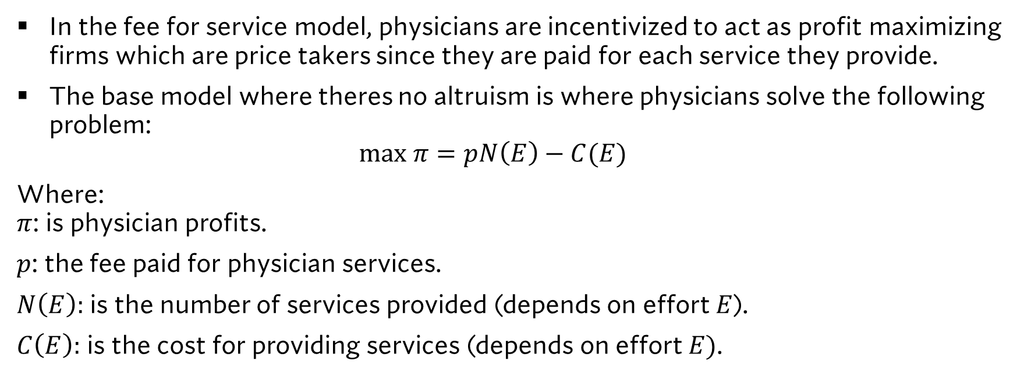
Physician Behavior: Fee for service
In the fee for service model, physicians are incentivized to act as profit maximizing firms which are price takers since they are paid for each service they provide.
The base model where theres no altruism is where physicians solve the following problem: $max π=pN\left(E\right)−C(E)$
Where: $π$: is physician profits.
$p$: the fee paid for physician services.
$N\left(E\right):$ is the number of services provided (depends on effort $E$).
$C\left(E\right):$ is the cost for providing services (depends on effort $E)$.

Slide 13
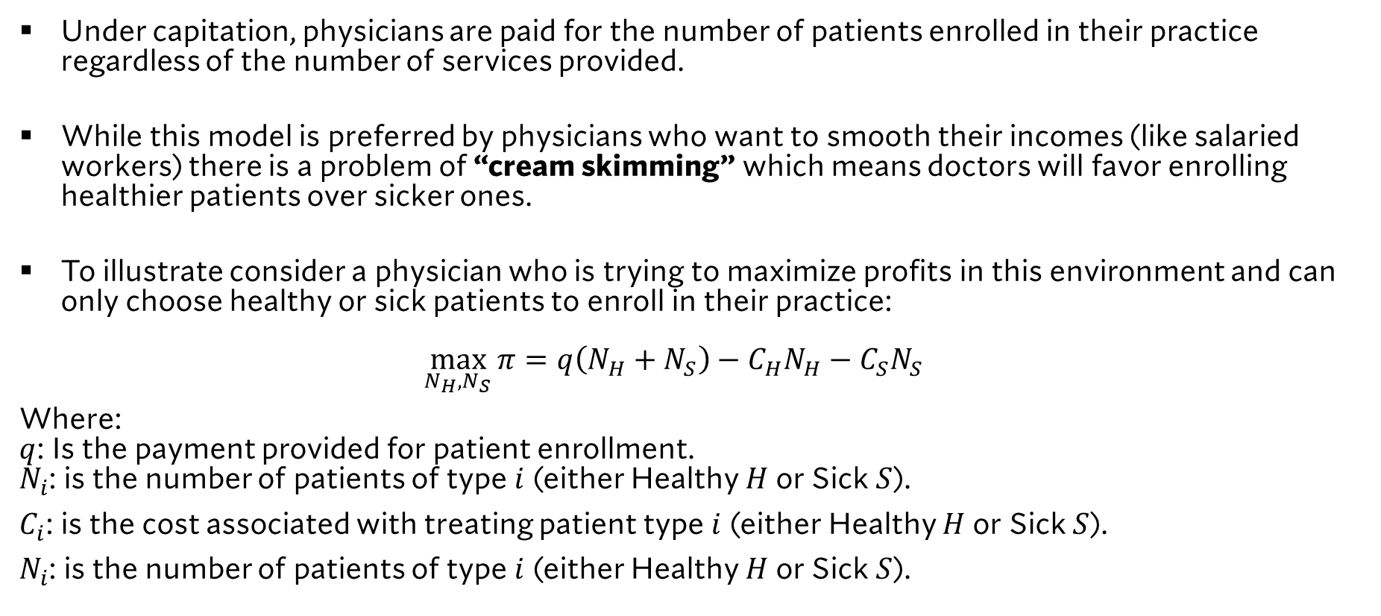
Physician Behavior: Capitation/per Capita
Under capitation, physicians are paid for the number of patients enrolled in their practice regardless of the number of services provided.
While this model is preferred by physicians who want to smooth their incomes (like salaried workers) there is a problem of “cream skimming” which means doctors will favor enrolling healthier patients over sicker ones.
To illustrate consider a physician who is trying to maximize profits in this environment and can only choose healthy or sick patients to enroll in their practice: $\max_{N_{H},N_{S}}{π}=q\left(N_{H}+N_{S}\right)−C_{H}N_{H}−C_{S}N_{S}$
Where: $q$: Is the payment provided for patient enrollment. $N_{i}$: is the number of patients of type $i$ (either Healthy $H$ or Sick $S$).
$C_{i}$: is the cost associated with treating patient type $i$ (either Healthy $H$ or Sick $S$).
$N_{i}$: is the number of patients of type $i$ (either Healthy $H$ or Sick $S$).

Slide 14
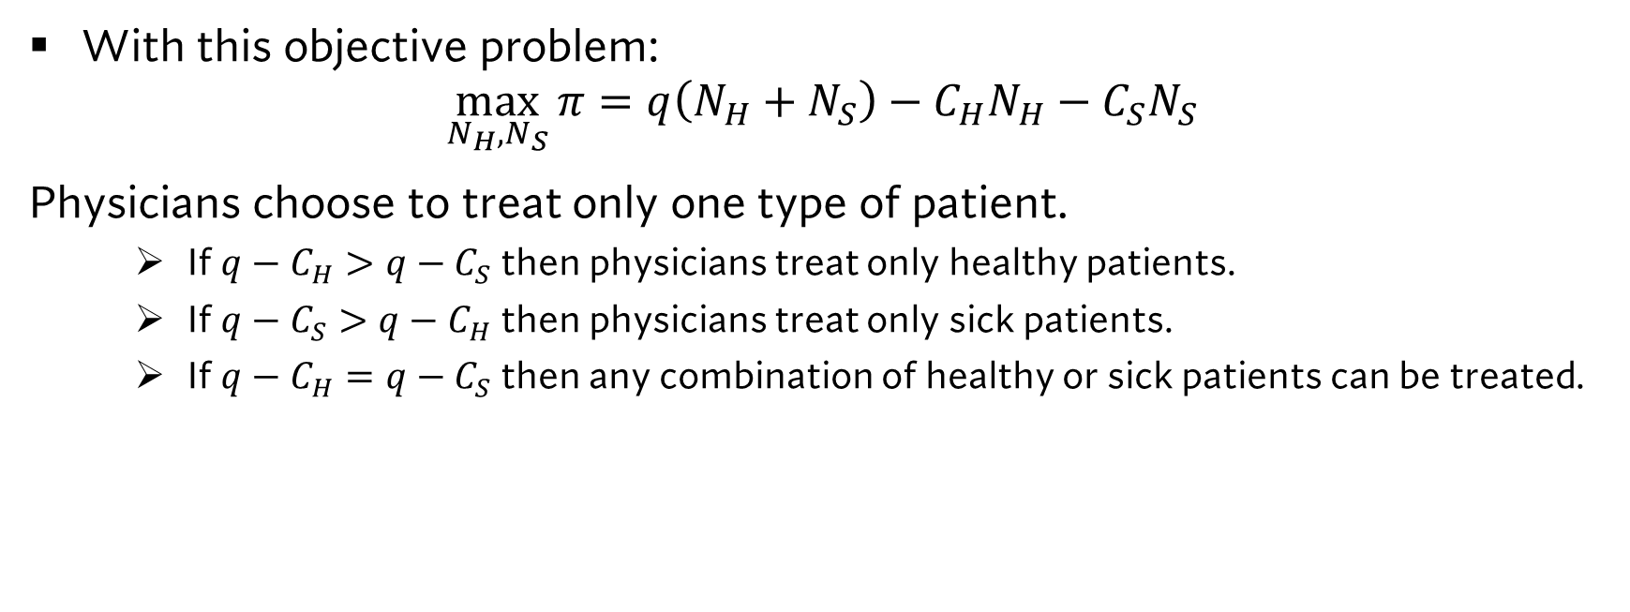
Physician Behavior: Capitation/per Capita
With this objective problem:
$$\max_{N_{H},N_{S}}{π}=q\left(N_{H}+N_{S}\right)−C_{H}N_{H}−C_{S}N_{S}$$ Physicians choose to treat only one type of patient.
If $q−C_{H}>q−C_{S}$ then physicians treat only healthy patients.
If $q−C_{S}>q−C_{H}$ then physicians treat only sick patients.
If $q−C_{H}=q−C_{S}$ then any combination of healthy or sick patients can be treated.

Slide 15
Canadian Healthcare: The Provincial Schedule of Medical Benefits

Slide 16

What is the schedule of Medical Benefits
A Schedule of Medical Benefits is a list of medical services, procedures, or treatments that are covered under a health insurance or public health plan.
It specifies what is reimbursable, at what rate, and under what conditions.
Its useful because it standardizes the kind of coverage across the healthcare system and ensures consistent payments to providers.
It acts as a reference for billing and from a government perspective is seen as a tool for controlling costs while allowing doctors to determine how much they want to work.

Slide 17





Who determines the fee?
The determination of fees for procedures in canada results from bargaining between the provincial medical association (representing physicians) and the provincial ministry of health (representing the taxpayers and govt).
This market structure is a Bilateral Monopoly as individual doctors cannot bargain for fees individually.
In the case of Ontario this is between the Ontario Medical Association and Ontario Ministry of Health.
OHIP

Slide 18
The schedule of medical benefits as a policy device
Code | 2010-10-01 | 2011-04-01 | 2011-06-01 | 2011-07-01 | 2011-09-01 | 2012-04-01 | 2013-01-01 | 2013-04-01
X174 | 0% | 0% | 0% | 0% | 0% | -2% | 0% | 0%
X175 | 0% | 0% | 0% | 0% | 0% | -2% | 0% | 0%
X198 | 0% | 0% | 0% | 0% | 0% | -2% | 0% | 0%
X199 | 0% | 0% | 0% | 0% | 0% | -2% | 0% | 0%
X416 | 0% | 0% | 0% | 0% | 0% | -5% | 0% | 0%
X128 | 0% | 0% | 0% | 0% | 0% | -5% | 0% | 0%
X168 | 24% | 0% | 0% | 0% | 0% | -5% | 0% | 0%
Under fee for service, fee change can alter the incentives around what kind of care is provided by physicians.
Uneven fee change can radically alter physician behaviour.
While there are “lone codes” which are targeted for revision often codes are revised in groups.

Slide 19
Concluding remarks on the schedule of medical benefits
The schedule of medical benefits can incentivize he kind of care that is provided.
This can impact the services provided by physicians and in turn patient health.
To maintain stability in physician behavior fee codes should be updated uniformly (with the same percentage change).

Slide 20
Learning Objectives
In this lecture we will discuss:
How to think about healthcare systems
Physician Payment Models: Fee for Service VS Capitation.
Canadian Healthcare: The Provincial Schedule of Medical Benefits.
Goal of this Lecture:
Understand different models of physician payment and how these payment schemes impact their behaviour.

